Slide 1
Lectuer-7 Database Design and Applications
Ashish Narang

Slide 2
First Semester
2020-21

Slide 3
Contents
Informal Guidelines for Relational Database Design
Functional Dependency
Normalization of Relations
Normal Forms based on Functional Dependencies

Slide 4
Informal Design Guidelines For Relational Database Design
What is relational database design?
–The grouping of attributes to form "good" relation Schemas
Two levels of relation schemas
–The logical "user view" level
–The storage "base relation" level
Design is concerned mainly with base relations
What are the criteria for "good" base relations?

Slide 5
Contd..
Informal guideline that may be used as measures to determine the quality of relation and schema design are
-Imparting clear Semantics to attributes
-Reducing redundant information in tuples
-Reducing null values in tuples
-Disallowing the possibility of generating spurious tuples

Slide 6
Semantics of the Relation Attributes
GUIDELINE 1: Informally, each tuple in a relation should represent one entity or relationship instance. (Applies to individual relations and their attributes).
–Attributes of different entities (EMPLOYEEs, DEPARTMENTs, PROJECTs) should not be mixed in the same relation
–Only foreign keys should be used to refer to other entities
–Entity and relationship attributes should be kept apart as much as possible.
Bottom Line: Design a schema that can be explained easily relation by relation. The semantics of attributes should be easy to interpret.

Slide 7
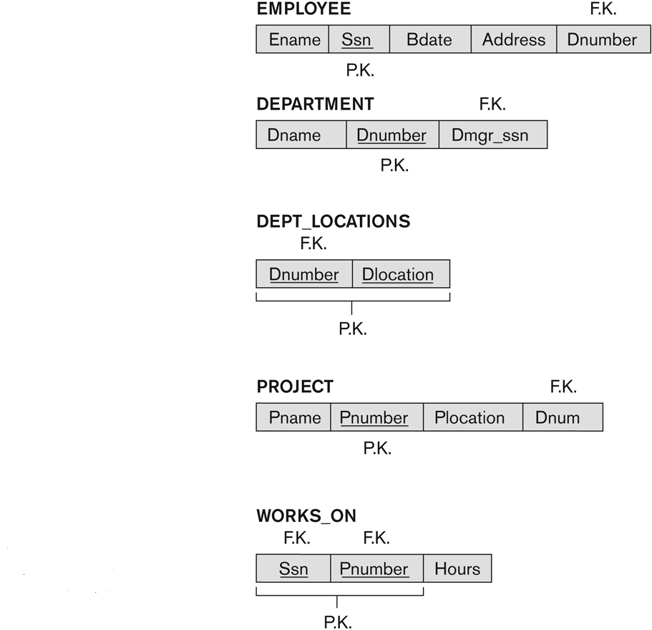
Result of Mapping the Company ER Schema into Relational Schema

Slide 8
Redundant Information in Tuples and Update Anomalies
Information is stored redundantly
–Wastes storage
–Causes problems with update anomalies
•Insertion anomalies
•Deletion anomalies
•Modification anomalies

Slide 9
EXAMPLE OF AN UPDATE ANOMALY
Consider the relation:
–EMP_PROJ(Emp_no, Proj_no, Ename, Pname, No_Hours)
Update Anomaly:
–Changing the name of project number P1 from “Billing” to “Customer-Accounting” may cause this update to be made for all 100 employees working on project P1.

Slide 10
EXAMPLE OF AN INSERT ANOMALY
Consider the relation:
–EMP_PROJ(Emp_no, Proj_no, Ename, Pname, No_Hours)
Insert Anomaly:
–Cannot insert a project unless an employee is assigned to it.
Conversely
–Cannot insert an employee unless an he/she is assigned to a project.

Slide 11
EXAMPLE OF DELETE ANOMALY
Consider the relation:
–EMP_PROJ(Emp_no, Proj_no, Ename, Pname, No_Hours)
Delete Anomaly:
–When a project is deleted, it will result in deleting all the employees who work on that project.
–Alternately, if an employee is the sole employee on a project, deleting that employee would result in deleting the corresponding project.

Slide 12
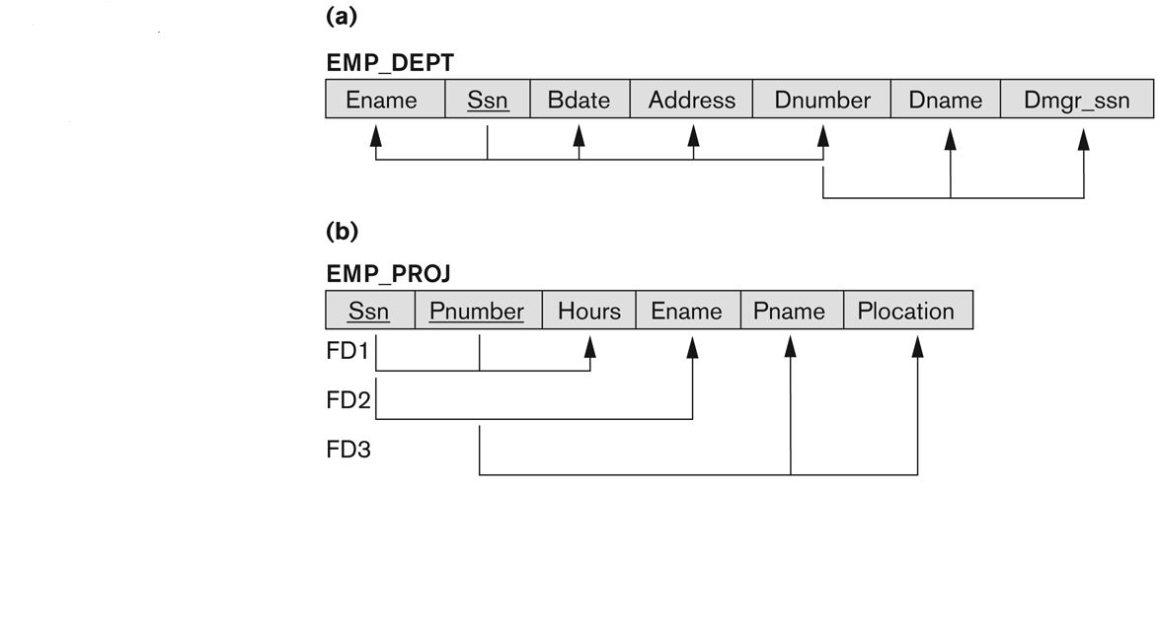
Two Relation Schemas Suffering From Update Anomalies

Slide 13
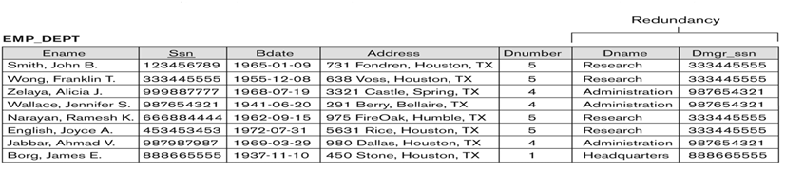
Example State for EMP_DEPT

Slide 14
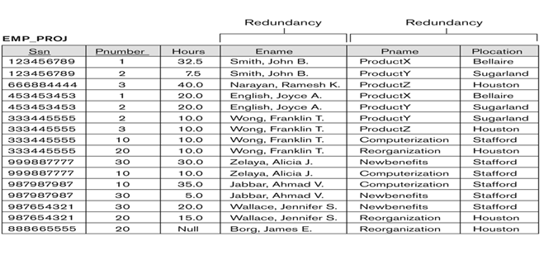
Example States For EMP_PROJ

Slide 15
Guideline to Redundant Information in Tuples and Update Anomalies
Design a schema that does not suffer from the insertion, deletion and update anomalies.
If there are any anomalies present, then note them so that applications can be made to take them into account.

Slide 16
Null Values in Tuples
GUIDELINE 3:
–Relations should be designed such that their tuples will have as few NULL values as possible
–Attributes that are NULL frequently could be placed in separate relations (with the primary key)
Reasons for nulls:
–Attribute not applicable or invalid
–Attribute value unknown (may exist)

Slide 17
Spurious Tuples
Bad designs for a relational database may result in erroneous results for certain JOIN operations
The "lossless join" property is used to guarantee meaningful results for join operations
GUIDELINE 4:
–The relations should be designed to satisfy the lossless join condition.
–No spurious tuples should be generated by doing a natural-join of any relations.

Slide 18
Contd..
There are two important properties of decompositions:
a)Non-additive or losslessness of the corresponding join
b)Preservation of the functional dependencies.
Note that:
–Property (a) is extremely important and cannot be sacrificed.
–Property (b) is less stringent and may be sacrificed.

Slide 19
Functional Dependencies
Functional dependency(FD) is a constraint between two sets of attributes from the database. A set of attributes X functionally determines a set of attributes Y if the value of X determines a unique value for Y.
Functional dependencies (FDs)
–Are used to specify formal measures of the "goodness" of relational designs
–And keys are used to define normal forms for relations
–Are constraints that are derived from the meaning and interrelationships of the data attributes

Slide 20
Contd..
X -> Y holds if whenever two tuples have the same value for X, they must have the same value for Y
–For any two tuples t1 and t2 in any relation instance r(R): If t1[X] = t2[X], then t1[Y] = t2[Y]
X -> Y in R specifies a constraint on all relation instances r(R)
FDs are derived from the real-world constraints on the attributes

Slide 21
Examples of FD constraints
Social security number determines employee name
–Ssn -> Ename
Project number determines project name and location
–Pnumber -> {Pname, Plocation}
Employee Ssn and project number determines the Hours per week that the employee works on the project
–{Ssn, Pnumber} -> Hours

Slide 22
Contd..
An FD is a property of the attributes in the schema R
The constraint must hold on every relation instance r(R)
If K is a key of R, then K functionally determines all attributes in R
–(since we never have two distinct tuples with t1[K] = t2[K])

Slide 23
Inference Rules for FDs
Given a set of FDs F, we can infer additional FDs that hold whenever the FDs in F hold
Armstrong's Inference Rules(IR):
–IR1. (Reflexive) If Y subset-of X, then X -> Y
–IR2. (Augmentation) If X -> Y, then XZ -> YZ
(Notation: XZ stands for X U Z)
–IR3. (Transitive) If X -> Y and Y -> Z, then X -> Z

Slide 24
Contd..
Some additional inference rules that are useful:
–Decomposition: If X -> YZ, then X -> Y and X -> Z
–Union: If X -> Y and X -> Z, then X -> YZ
–Psuedo transitivity: If X -> Y and WY -> Z,
then WX -> Z

Slide 25
Closure Set
Closure of a set F of FDs is the set F⁺ of all FDs that can be inferred from F
Closure of a set of attributes X with respect to F is the set X⁺ of all attributes that are functionally determined by X.
X⁺ can be calculated by repeatedly applying IR1, IR2, IR3 using the FDs in F.

Slide 26
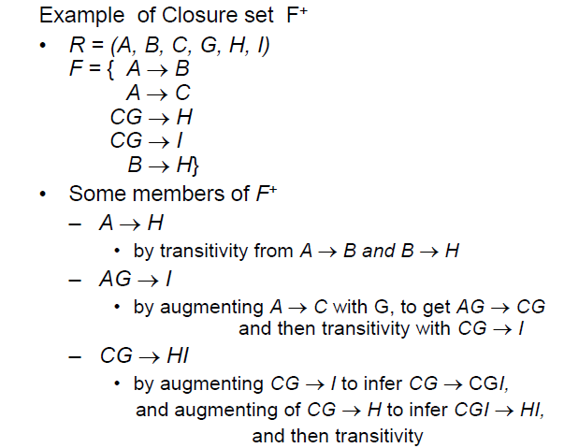
Contd..

Slide 27
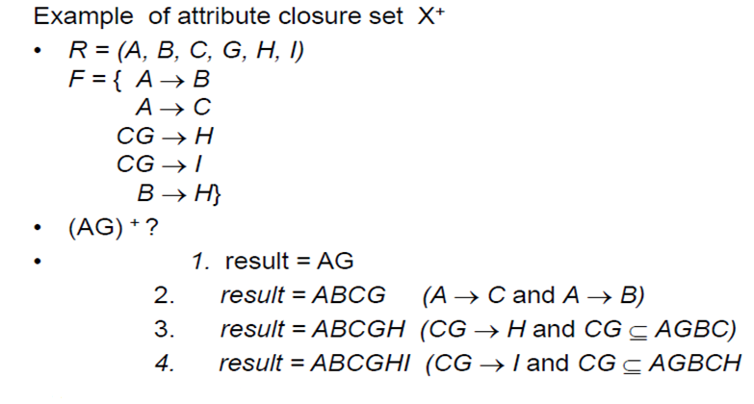
Contd..

Slide 28
Contd..
Uses of attribute set closures
–Determining super keys and candidate keys
–Determining if A B is a valid FD
Check if A⁺ contains B

Slide 29
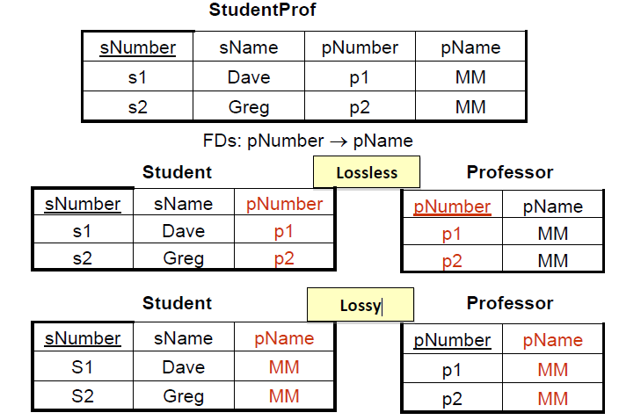
Decomposing Relations

Slide 30
Lossless vs. Lossy Decomposition
Assume R is divided into R1 and R2
Lossless Decomposition
–R1 natural join R2 should create exactly R
Lossy Decomposition
–R1 natural join R2 adds more records (or deletes records) from R

Slide 31
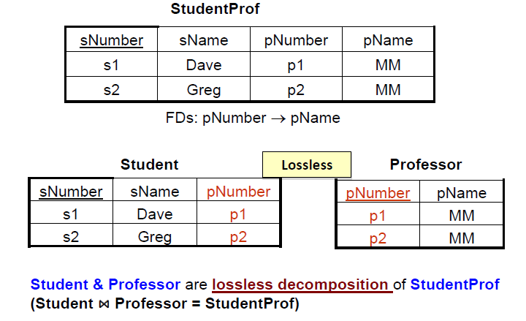
Lossless Decomposition

Slide 32
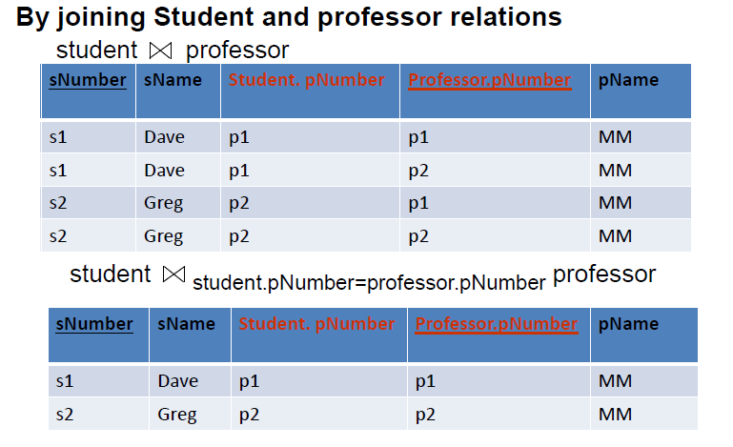
Lossless Decomposition

Slide 33
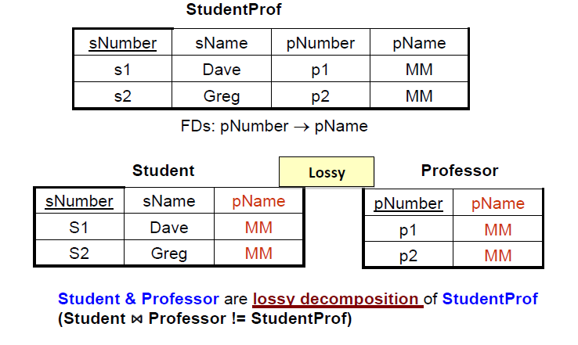
Lossy Decomposition

Slide 34
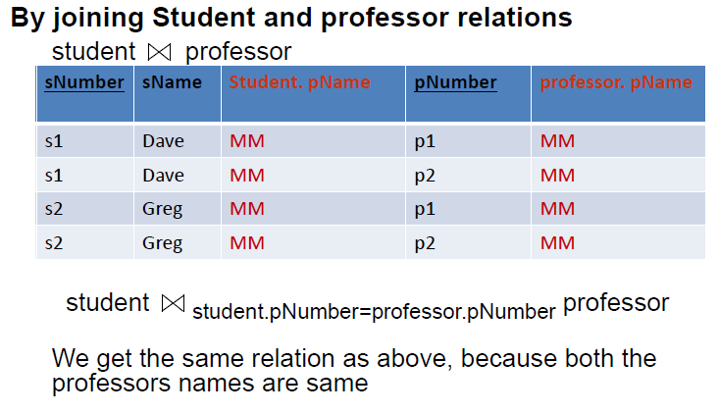
Lossy Decomposition

Slide 35
Goal: Ensure Lossless Decomposition
How to ensure lossless decomposition?
Answer:
–The common columns must be candidate key in one of the two relations.

Slide 36
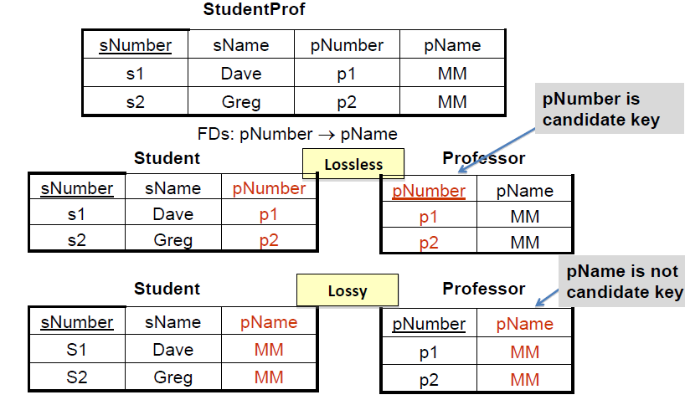
Contd..

Slide 37
Normalization of Relations
Normalization:
–The process of decomposing unsatisfactory "bad" relations by breaking up their attributes into smaller relations.
Normal form:
–Condition using keys and FDs of a relation to certify whether a relation schema is in a particular normal form.

Slide 38
Contd..
2NF, 3NF, BCNF
–based on keys and FDs of a relation schema
4NF
–based on keys, multi-valued dependencies : MVDs;
5NF
–based on keys, join dependencies : JDs
Additional properties may be needed to ensure a good relational design (lossless join, dependency preservation)

Slide 39
Practical Use of Normal Forms
Normalization is carried out in practice so that the resulting designs are of high quality and meet the desirable properties.
The practical utility of these normal forms becomes questionable when the constraints on which they are based are hard to understand or to detect.
The database designers need not normalize to the highest possible normal form.
–(usually up to 3NF, BCNF)
Denormalization:
–The process of storing the join of higher normal form relations as a base relation—which is in a lower normal form

Slide 40
Definitions of Keys and Attributes Participating in Keys
A superkey of a relation schema R = {A1,A2,....,An} is a set of attributes S subset-of R with the property that no two tuples t1 and t2 in any legal relation state r of R will have t1[S] = t2[S].

Slide 41
Contd..
If a relation schema has more than one key, each is called a candidate key.
–One of the candidate keys is arbitrarily designated to be the primary key, and the others are called secondary keys.
A Prime attribute must be a member of some candidate key.
A Nonprime attribute is not a prime attribute. i.e., it is not a member of any candidate key.

Slide 42
First Normal Form
Disallows
–multivalued attributes
attributes whose values for an individual tuple are non-atomic

Slide 43
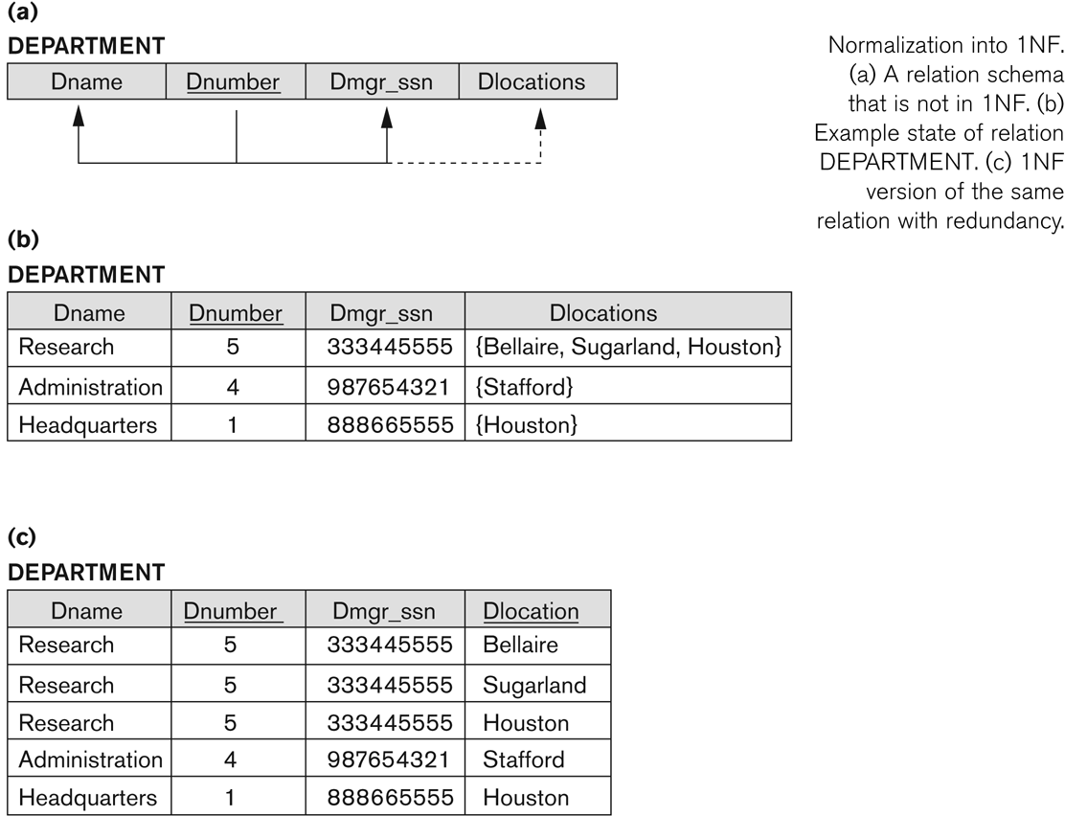
Normalization into 1NF

Slide 44
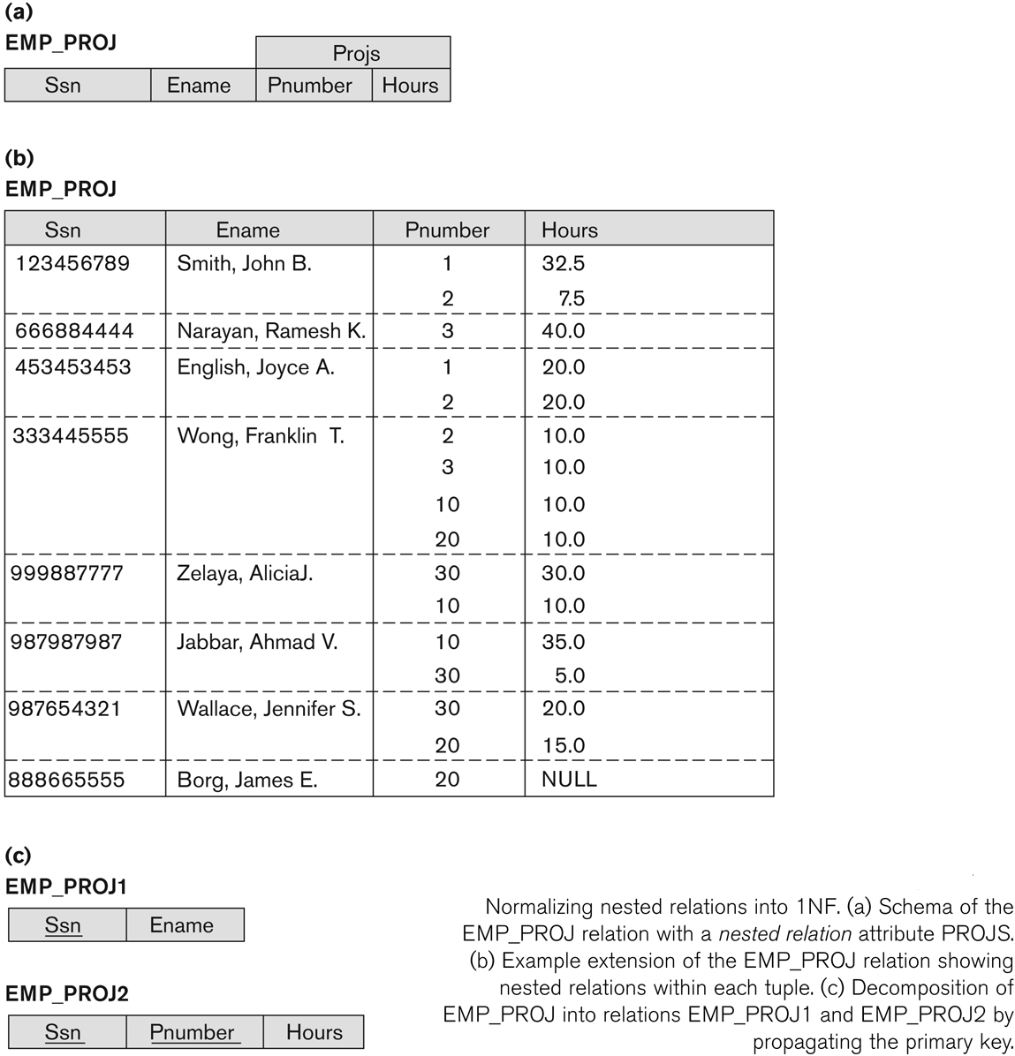
Normalizing nested relations into 1NF

Slide 45
Second Normal Form
Uses the concepts of FDs, primary key
Definitions
–Prime attribute: An attribute that is member of the primary key K
–Full functional dependency: a FD Y -> Z where removal of any attribute from Y means the FD does not hold any more
Examples:
–{Ssn, Pnumber} -> Hours is a full FD since neither Ssn -> Hours nor Pnumber -> Hours hold
–{Ssn, Pnumber} -> Ename is not a full FD (it is called a partial dependency ) since Ssn -> Ename also holds

Slide 46
Contd..
A relation schema R is in second normal form (2NF) if every non-prime attribute A in R is fully functionally dependent on the primary key.
R can be decomposed into 2NF relations via the process of 2NF normalization.

Slide 47
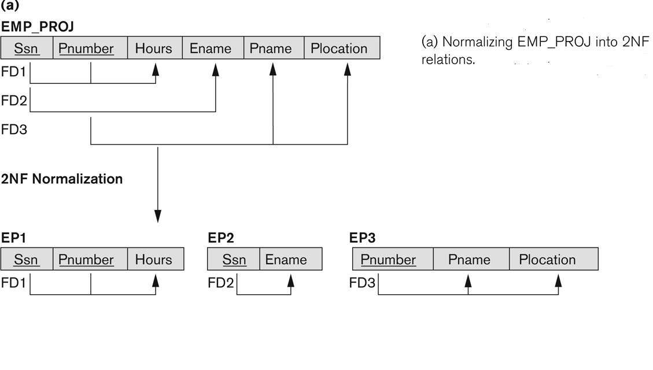
Normalizing into 2NF

Slide 48
Third Normal Form
Definition:
–Transitive functional dependency: a FD X -> Z that can be derived from two FDs X -> Y and Y -> Z
Examples:
-Ssn -> DMGRSsn is a transitive FD
-Since Ssn -> DNUMBER and DNUMBER -> DMGRSsn hold
-Ssn -> Ename is non-transitive
-Since there is no set of attributes X where Ssn -> X and X -> Ename

Slide 49
Contd..
A relation schema R is in third normal form (3NF) if it is in 2NF and no non-prime attribute A in R is transitively dependent on the primary key
R can be decomposed into 3NF relations via the process of 3NF normalization
NOTE:
–In X -> Y and Y -> Z, with X as the primary key, we consider this a problem only if Y is not a candidate key.
–When Y is a candidate key, there is no problem with the transitive dependency .
–E.g., Consider EMP (Ssn, Emp_no, Salary ).
Here, Ssn -> Emp_no -> Salary and Emp_no is a candidate key.

Slide 50
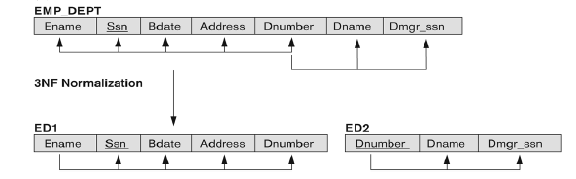
Normalizing into third normal form

Slide 51
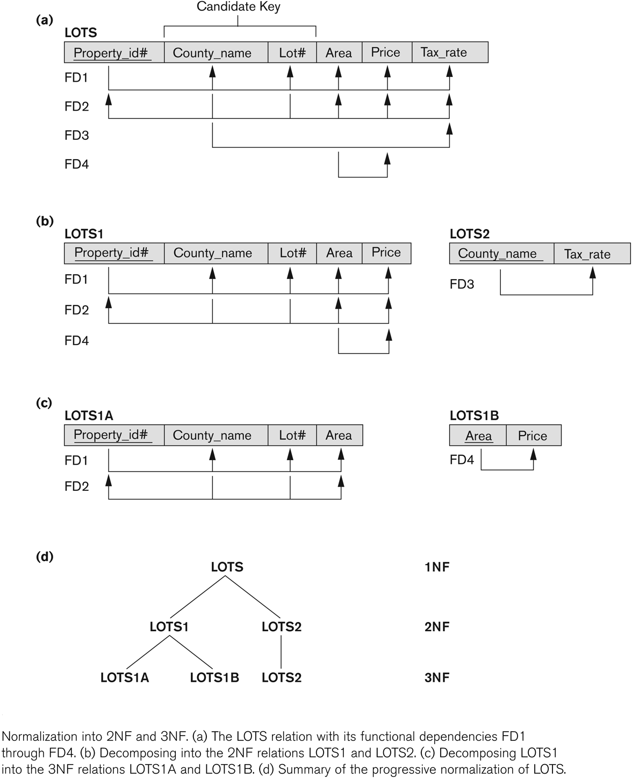
Normalization into Second and Third Normal Form

Slide 52
BCNF (Boyce-Codd Normal Form)
A relation schema R is in Boyce-Codd Normal Form (BCNF) if whenever an FD X -> A holds in R, then X is a superkey of R
Each normal form is strictly stronger than the previous one
–Every 2NF relation is in 1NF
–Every 3NF relation is in 2NF
–Every BCNF relation is in 3NF
There exist relations that are in 3NF but not in BCNF
The goal is to have each relation in BCNF (or 3NF)

Slide 53
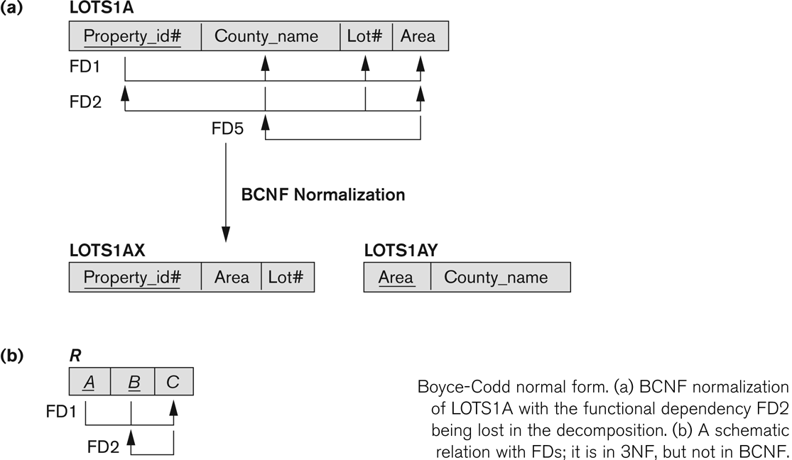
Contd..

